Slide 1
Intro to REA
Selected slides from Bill McCarthy, the father of REA
- and a few slides from me and Lynn,
and a few slides from Jesper Kiehn
about REA compositional contracts.

Slide 2
R
E
A
Economic Resource
stockflow
Economic Event
participation
Economic Agent
duality
The REA pattern

Slide 3
REA started as an internal company accounting model.
Now that other views have emerged,
that is called “the trading partner view”.
The next set of slides describes that view.

Slide 4
Once upon a time at the cookie store ……
an accounting story

Slide 5

Cookie-Monster (the customer) and Elmo (the entrepreneur) meet in the (real or virtual) marketplace, thus setting the stage for an Economic Exchange

Slide 6

Cookie-Monster and Elmo engage in a SALE (transfer of Cookie Inventory)

Slide 7
Economic Resource
Cookies
Economic Agent
insideParticipate
entrepreneur
Economic Event
stock-flow
Sale
Economic Agent
outsideParticipate
duality
customer
Economic Agent
insideParticipate
Economic Event
stock-flow
outsideParticipate
Economic Agent
Economic Resource
A patterned category model for exchange process

Slide 8

Cookie-Monster and Elmo engage in a PAYMENT (transfer of Cash)

Slide 9
Economic Resource
Cookies
Economic Agent
insideParticipate
entrepreneur
Economic Event
stock-flow
Sale
Economic Agent
outsideParticipate
duality
customer
Economic Agent
insideParticipate
Economic Event
entrepreneur
stock-flow
Cash-Receipt
outsideParticipate
Economic Agent
Economic Resource
customer
Cash
A patterned category model for exchange process

Slide 10
The preceding slides described exchanges.
But REA also describes production processes with resource inputs and outputs.
ResourceA
Process
ResourceC
ResourceB

Slide 11
And REA has 3 layers:
Types, classifications, policies, recipes
Plans, schedules, agreements
Execution, events, observations, reports of what happened (aka the accountability layer)

Slide 12
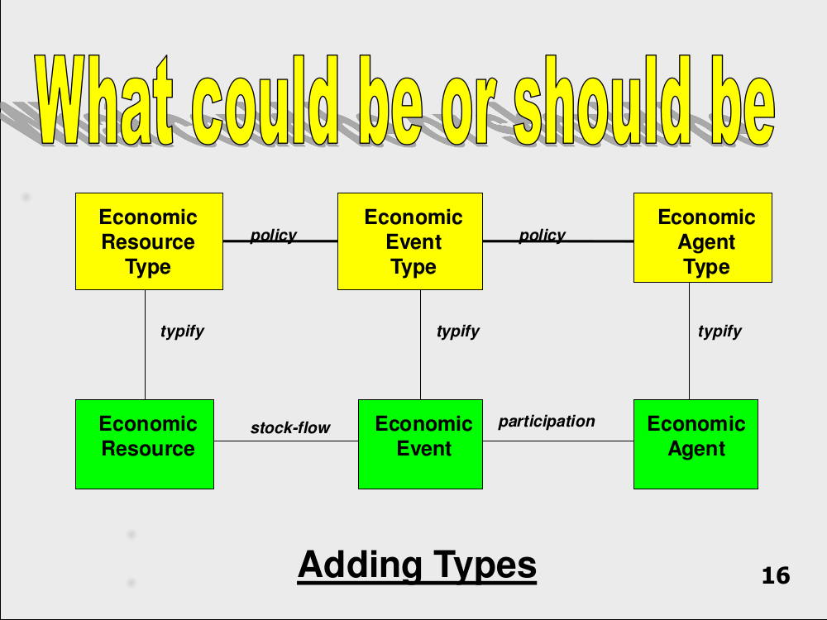

Slide 13
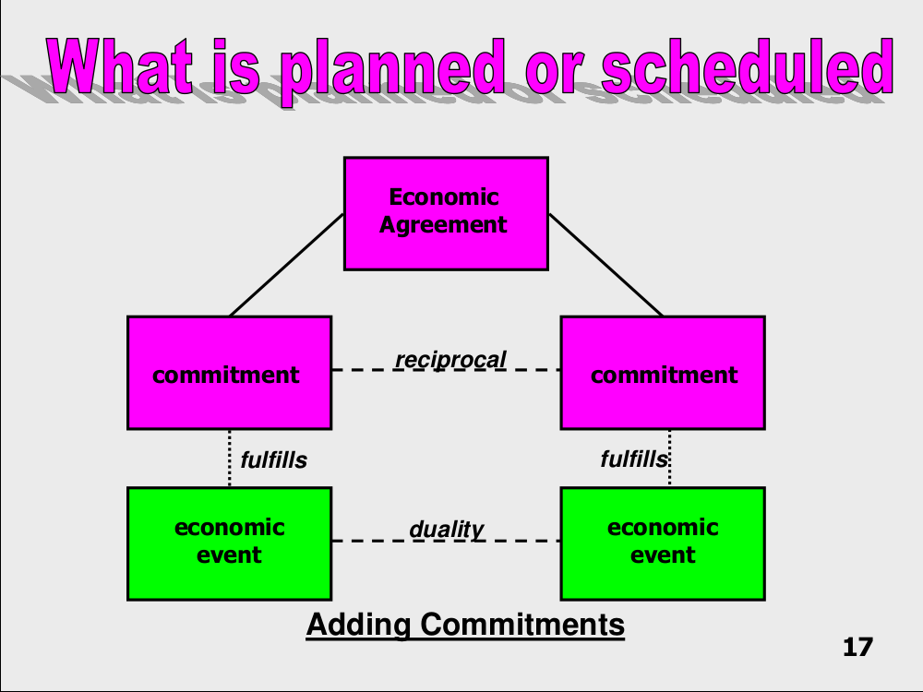

Slide 14


REA Temporal Expansion (M2 Trading Partner View)
The POLICY layer
typify
policy
policy
Economic Event Type
policy
Economic Agent Type
typify
typify
The SCHEDULING layer
specify
specify
specify
bundle
trigger
Economic Commitment
reciprocal
insidePromise
outsidePromise
reserve
fulfill
reserve
insideParticipate
Economic Resource
stockFlow
Economic Event
Economic Agent
responsible
outsideParticipate
The ACCOUNTABILITY layer
duality
The POLICY layer – “What could be or should be”: REA Types; typify, policy
The SCHEDULING layer – “What has been specified or reserved”: Economic Commitments, Economic Contracts; fulfill, specify, reserve, reciprocal, trigger, promise {inside, outside}
The ACCOUNTABILITY layer – “What has occurred”: Economic Resources, Events, and Agents; duality, stockFlow, participate {inside, outside}, responsible

Slide 15
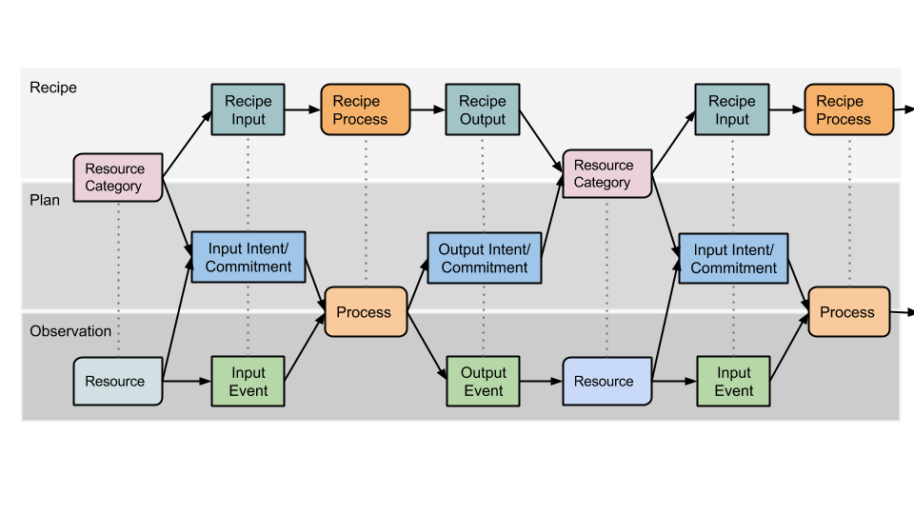
From Recipe to Salsa

Slide 16
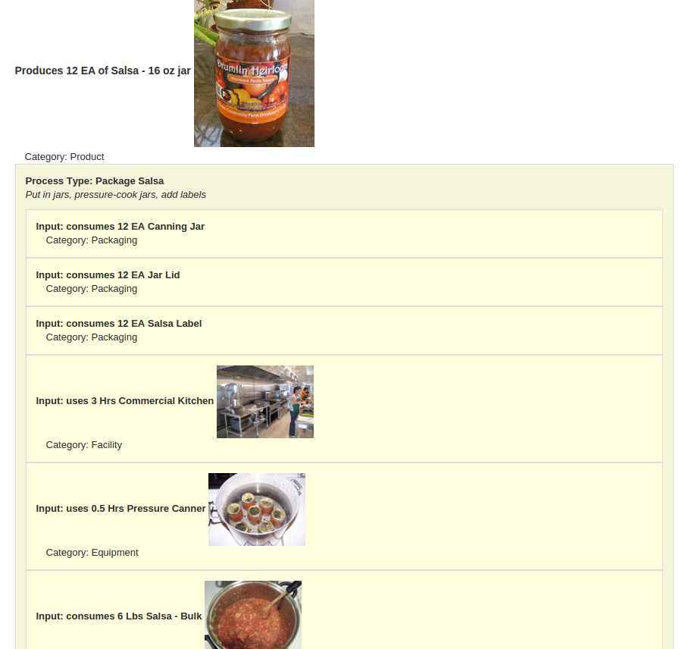
Salsa Recipe

Slide 17
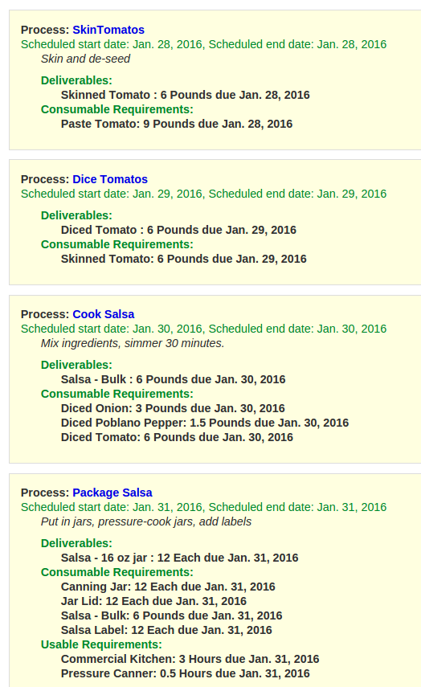
Salsa Plan

Slide 18
Salsa Recipe
for 1 lb of Salsa
(fills 2 jars)
1 lb Diced Tomato
Cook Salsa
1 lb Salsa - Bulk
1 lb Salsa - Bulk
Package Salsa
Diced Tomato
Salsa - Bulk
Schedule:
Order for 12
jars of Salsa
6 lb Diced Tomato Today
6 lb Salsa - Bulk Today
6 lb Salsa - Bulk Today
Cook Salsa Today
Package Salsa Today
Reality:
Salsa
Events
Diced Tomato Lot 234
Consumed 6 lb Diced Tomato Lot 234
Produced 6 lb Salsa - Bulk Lot 456
Salsa - Bulk Lot 456
Consumed 6 lb Salsa -Bulk Lot 456

Slide 19
The previous slides showed REA
as an internal accounting pattern, the “trading partner view”.
The next slides will move to the external,
or independent,
or “economic network view”.

Slide 20
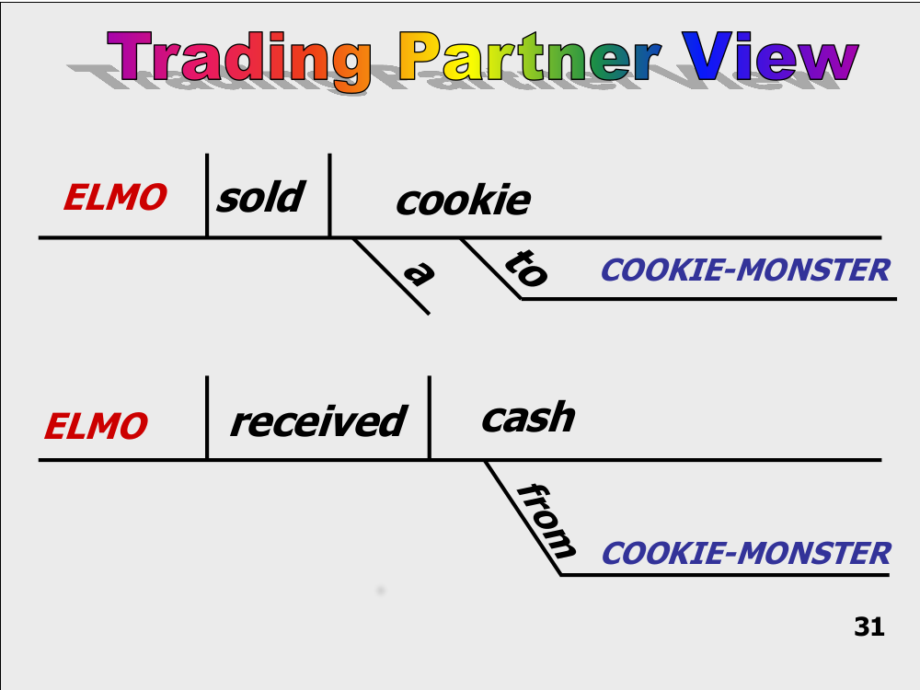

Slide 21
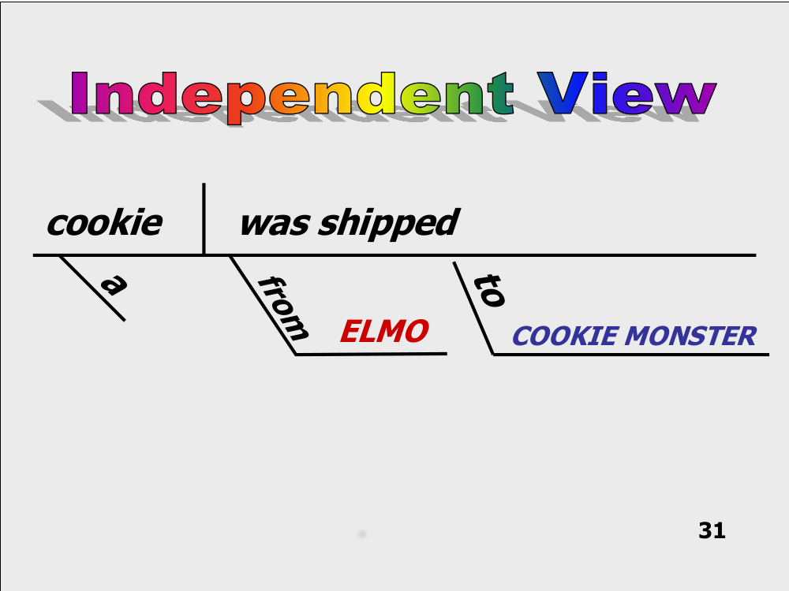

Slide 22
Lynn, Sensorica, and I contributed several improvements to the REA model:
The independent view (which enables supply chains, collaboration spaces, and other economic networks)
Value networks
Value equations
Recipes
Those improvements will be included
in a new REA American Accounting Association monograph.

Slide 23
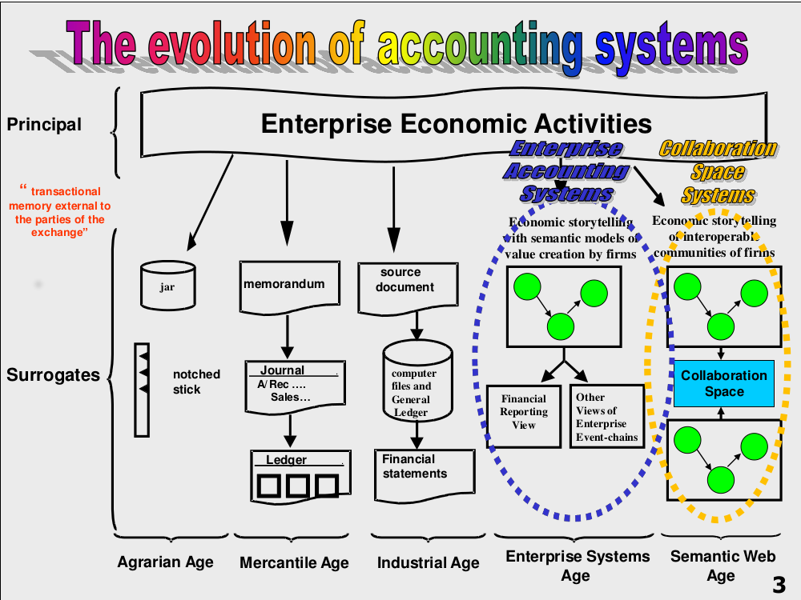

Slide 24
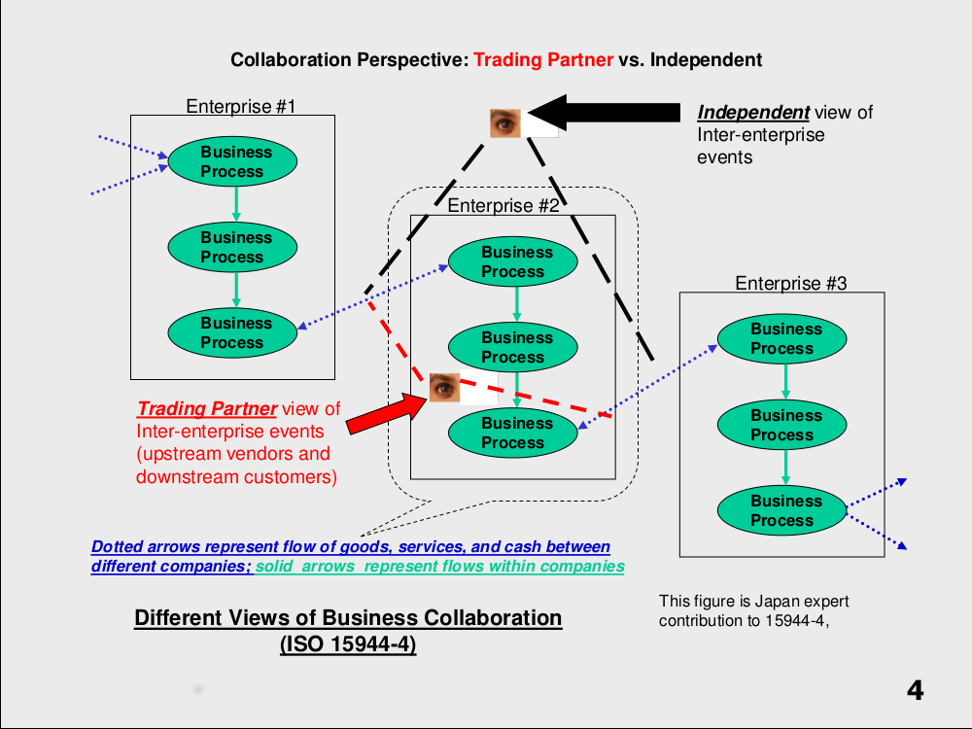
“Business Process” is shorthand for
some combination of REA Processes
and Exchanges, like “Purchasing”.

Slide 25
Processes and Exchanges can alternate in Value Flows that cross different Agents
Agent1
Agent1
ResourceA
Process
ResourceB
Exchange
Agent2
ResourceB

Slide 26


Slide 27
Accountability Layer for an Open Value Network (like Sensorica)
labor
materials
creating value
equipment
Contribution
(project step)
duality
prototypes
Deliverable
Project
stockFlow
ideas
Contribution (project step)
duality
designs
other
distributing value
transfer or use of project value to party outside the value network
stockFlow
payment or value enhancement distribution to individual value creators based on value accounting system
duality
Value accounting system uses REA model of material or assets purchased + labor + roles played + tasks accomplished + prototype or designs submitted + creative ideas + other factors deemed relevant by network participants

Slide 28
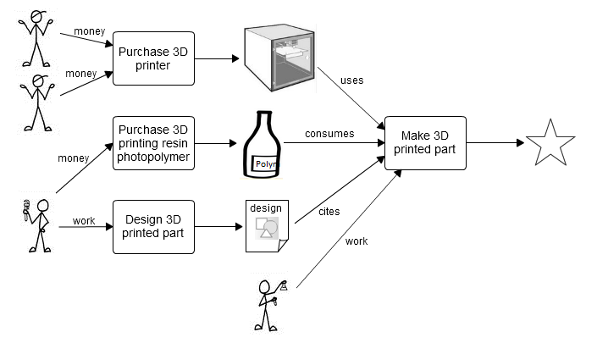
Here is the resource flow for creating the product...

Slide 29
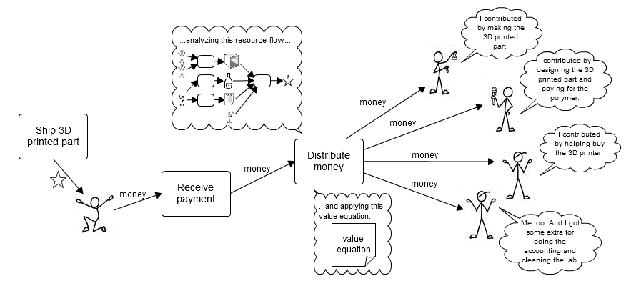
Here is how the income gets distributed...

Slide 30
All these views and layers are connected,
so systems can walk through all of them,
If they have permission.

Slide 31
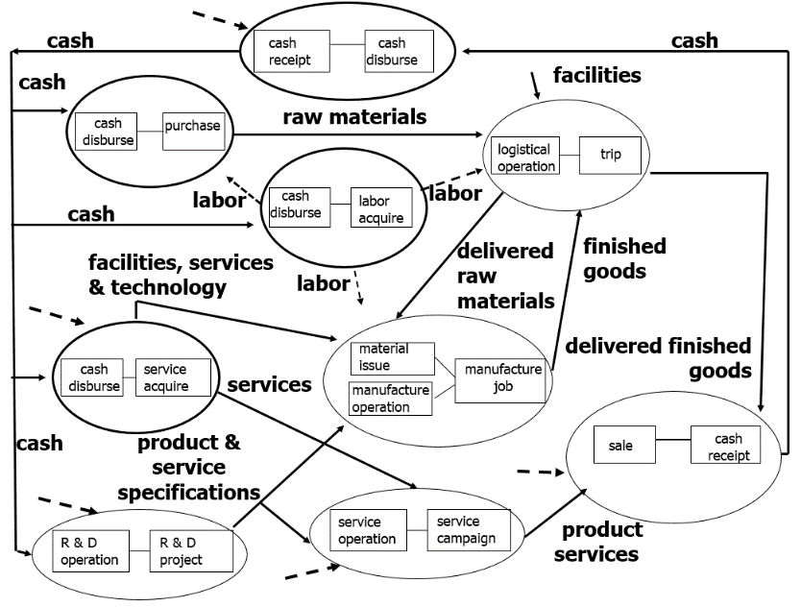
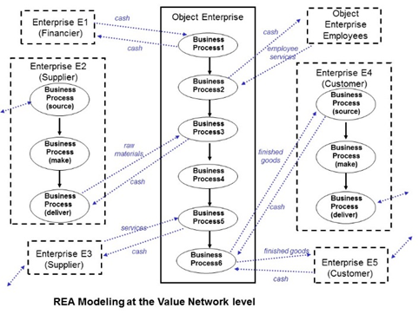

External view
Internal Value Chain
Cash
Cash Disbursement
Cashier
Vendor
Vendor
Purchase
Buyer
Raw Material
Workflow
Business Process

Slide 32

REAContracts
Adding sematics to business contracts
Jesper Kiehn (Simon Peyton-Jones)

Slide 33
Composable REA Contracts
Idea is from Modelling Financial contracts by Simon Peyton-Jones
REA Contracts are a subset of the possible financial contracts
REA contracts are normally about money for goods but can also be for services
1

Slide 34
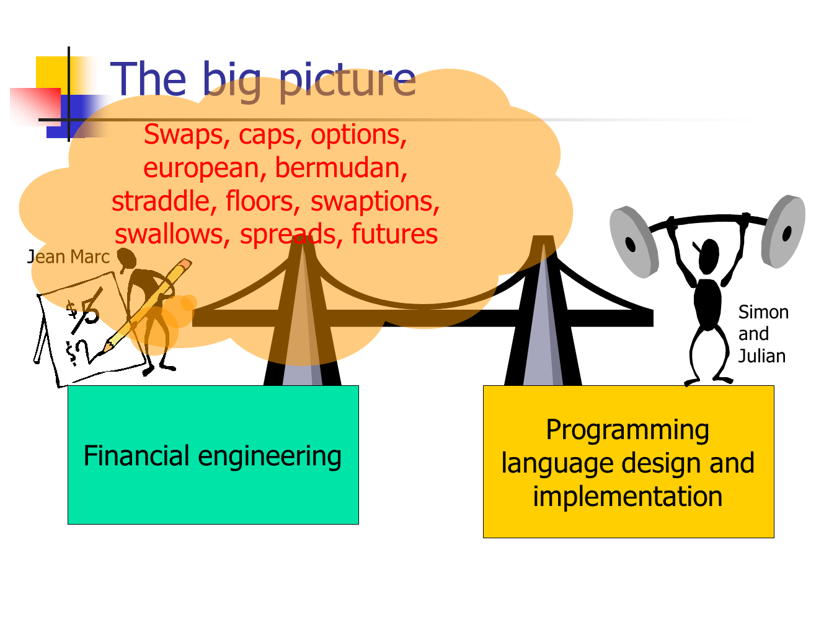
2

Slide 35
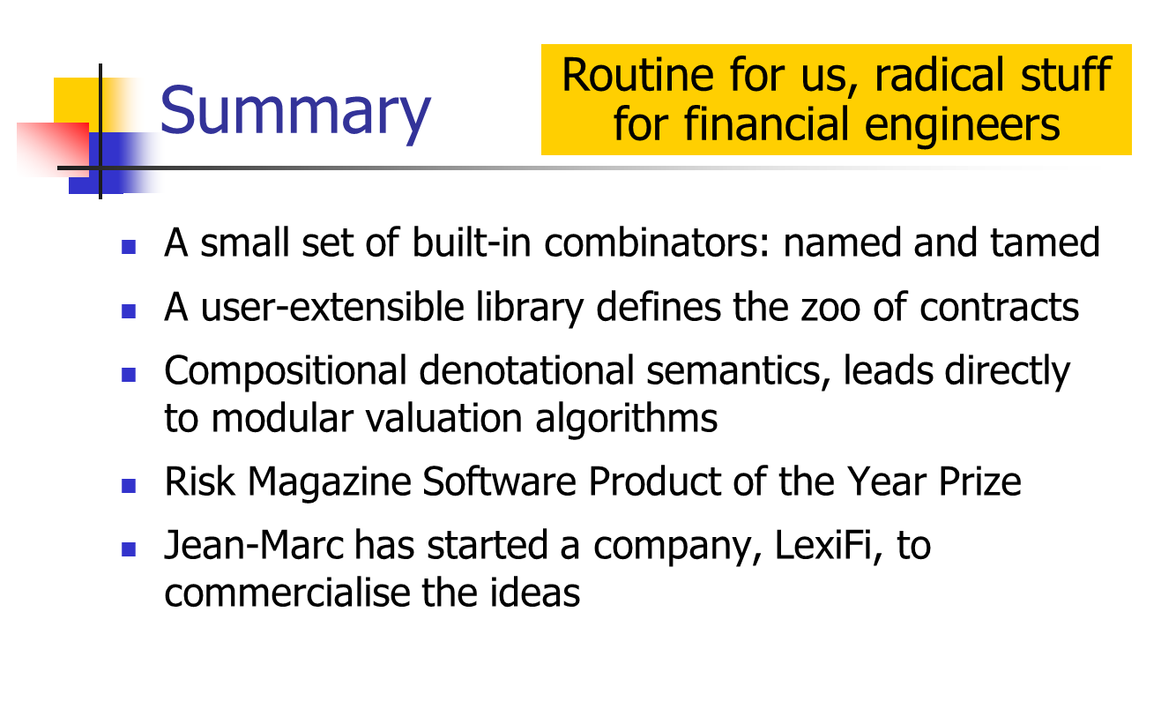
16

Slide 36
Links (from Jesper)
https://www.microsoft.com/en-us/research/people/simonpj/
http://www.dslfin.org/resources.html
https://www.fairmat.com/
http://hiperfit.dk/
https://www.lexifi.com/

